Slide 1
Chapter 4
Arrays and Strings
Er. Amrit Poudel

Slide 2
Contents
5.1 Introduction to arrays
5.2 Types of Arrays
1-D Array
Multidimensional Array
5.3 Character I/O statements
5.4 Strings
5.5 String I/O statement
5.6 String Handling functions
5.7 Array of string

Slide 3
5.1 Introduction to arrays
Do you find any difficulties to solve this problem?
WAP to enter one hundred integers and display their sum.

Slide 4
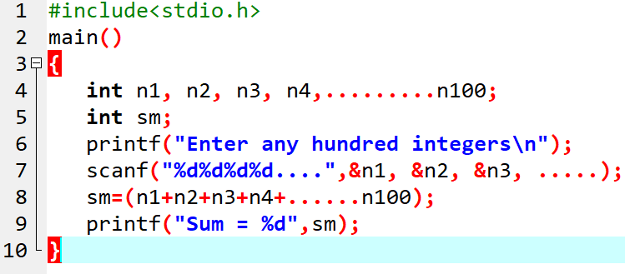
5.1 Introduction to arrays (Contd.)
Your basic solution could be:

Slide 5
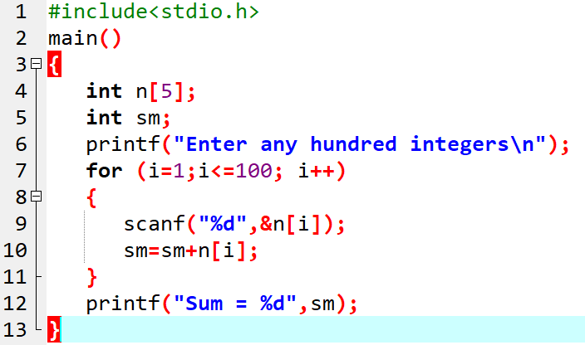
5.1 Introduction to arrays (Contd.)
Will this be better?
Here, n[5] is an array.
It holds 5 integer data only.

Slide 6
5.1 Introduction to arrays (Contd.)
An array is a group of similar datatype that share a common name.
This means that an array can store either all integers, or all floating point numbers or all characters.
The individual data items stored in an array are called its elements.
Eg: int n[5]
This n is an array that can store five integer values.

Slide 7
5.2 Types of Arrays
Two types:
Single Dimensional Array
Multidimensional Array
2-D
3-D
And so on.

Slide 8
i) Single Dimensional (1D) array
Used to store a list of items that are of similar type.
General Syntax:
Dataype arrayname[size];
Eg:
int num[5];
where, int specifies datatype of variable,
num specifies array-name,
size specifies the maximum no. of elements
num[0] | num[1] | num[2] | num[3] | num[4]

Slide 9
Initialization of 1-D array
Compile-time Initialization
Eg:
int num[3]= {10, 20, 30, 40];
int num[ ]= {10, 20, 30, 40};
Or
int num[3];
num[0]=10;
num[1]=20;
num[2]=30;
num[3]=40;
b) Run-time Initialization
Eg:
for ( i=0 ; i<10 ; i++)
{
scanf(“%d”, &num[i]);
}

Slide 10
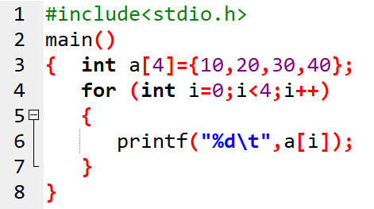

Prog. 1: WAP to initialize a set of certain numbers to demonstrate compile time initialization of 1-D array. Also display those numbers.

Slide 11
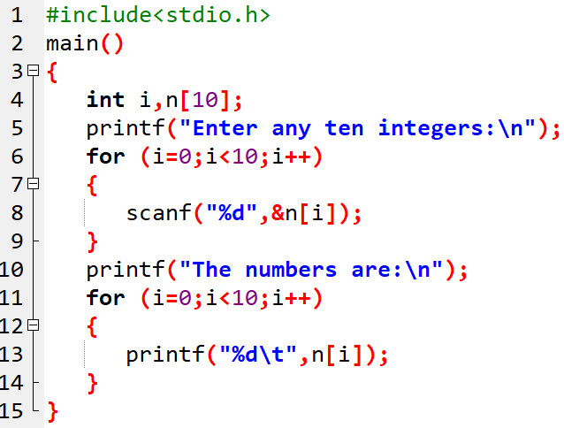

Prog. 2: WAP to read 10 numbers from the user and display them using array.

Slide 12
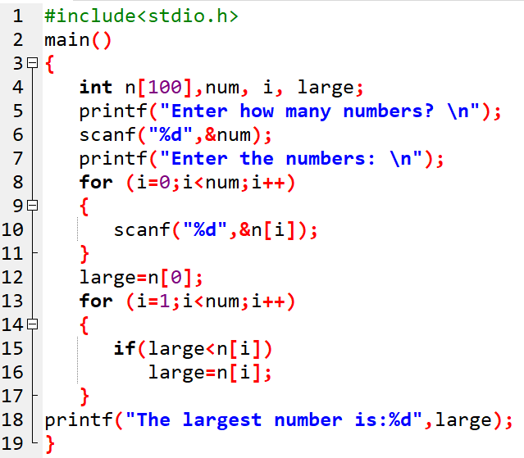
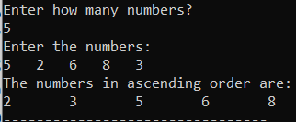
Prog. 3: WAP to input n numbers and find the largest among them.

Slide 13
ii) Multidimensional array
Multidimensional arrays are those which have more than one dimension.
It can be 2-D, 3-D and so on.
They are defined in the same manner as 1-D array except that a separate pair of square bracket is required for each dimension.
The general form is:
Datatype arrayName [size1] [size2]…[sizeN];

Slide 14
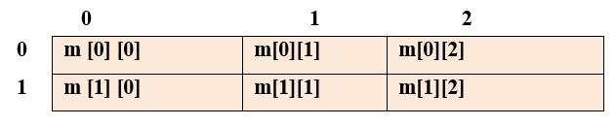
2-D array
The simplest form of multidimensional array is the 2-D array.
2-D array has two subscript.
Eg: int n[2][3]
Here 2 represents two rows and 3 represents three column

Slide 15
Initialization of 2-D array
Compile-time Initialization
Eg:
int num [3][3] = { {1,2,3} , {4,5,6} , {7,8,9} };
int num [ ][3] = { {1,2,3} , {4,5,6} , {7,8,9} };
or
int num[3][3];
num[0][0]=1;
num[0][1]=2;
num[0][2]=3;
………………….
num[3][3]=9;
b) Run-time Initialization
Eg:
for (i=0;i<2;i++)
{
for(j=0;j<2;j++)
{
scanf("%d",&m[i][j]);
}
}

Slide 16
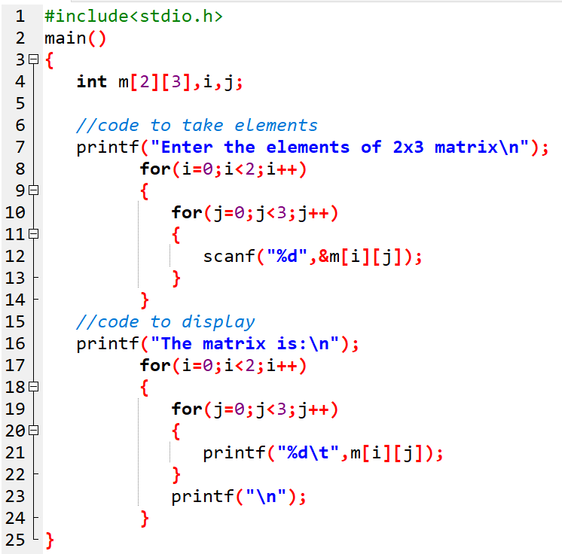
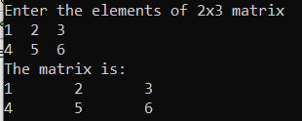
Prog. 4: WAP to read a matrix of size 2x3 from the user and display them on the screen.

Slide 17
Assignment 1:
WAP to read values of 3 × 3 order matrix, then compute the sum of even elements.
WAP to find the sum of all elements of a 3 × 3 matrix.
WAP using array to enter n numbers and display the sum of those numbers which are greater than 10.

Slide 18
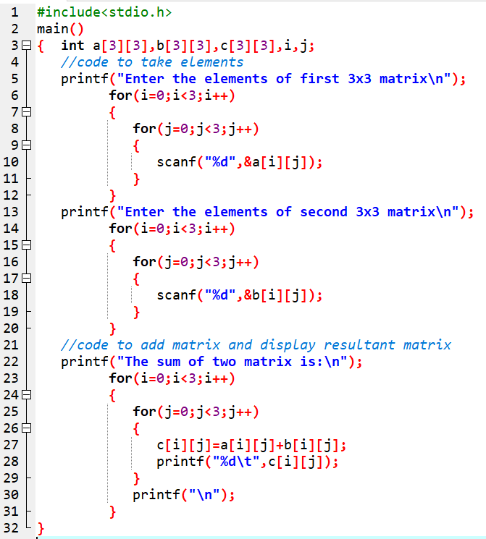
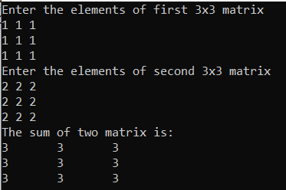
Prog. 5: WAP to read the elements of given two matrix of order 3x3 from the user and perform matrix addition.

Slide 19
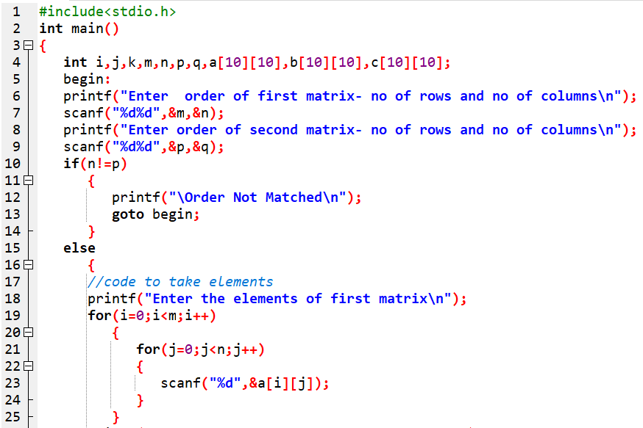
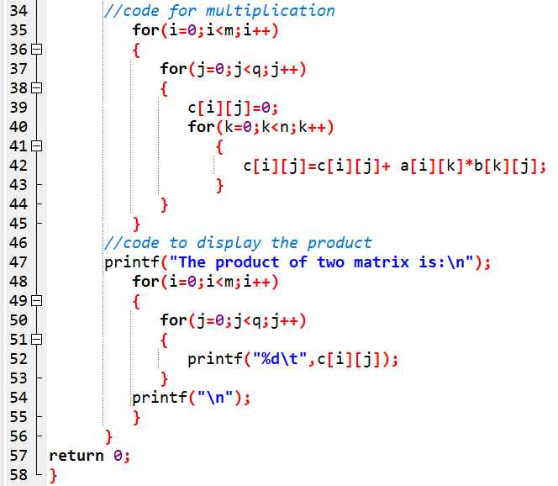
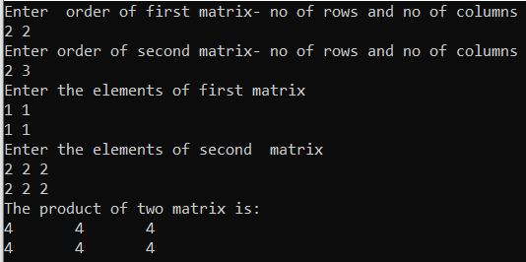
Prog. 6: WAP to enter two matrix of mxn size and perform matrix multiplication, and display the result.

Slide 20
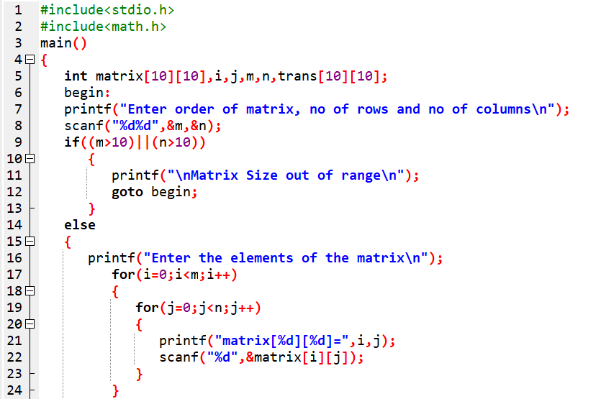
Prog. 7: WAP to read order of a matrix and its elements. Find the transpose matrix of the input matrix.

Slide 21
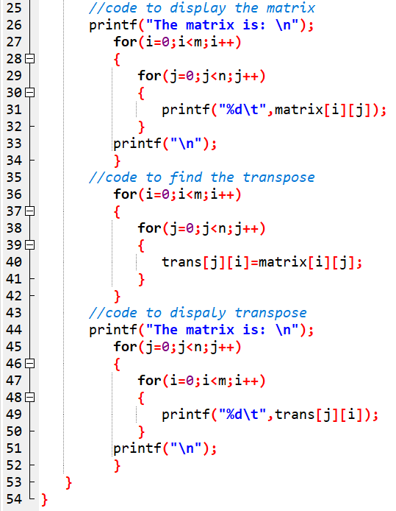
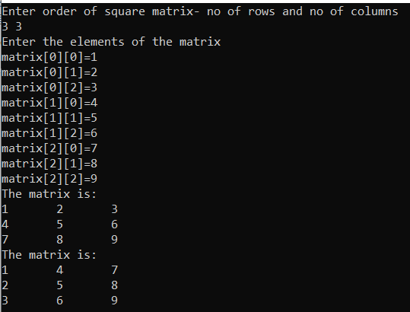

Slide 22
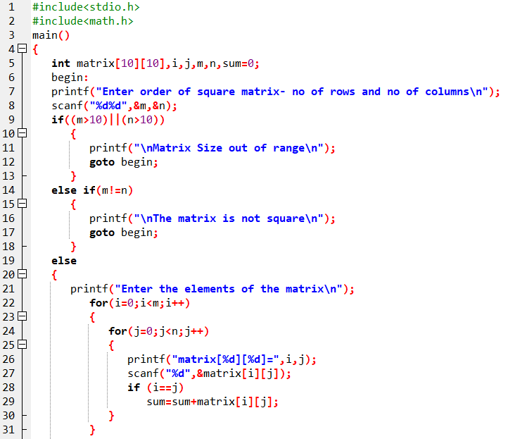
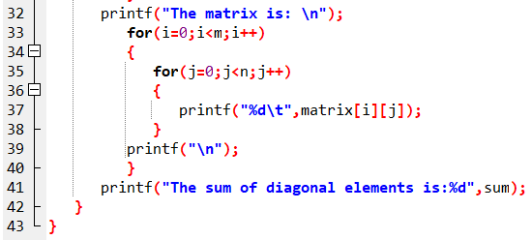
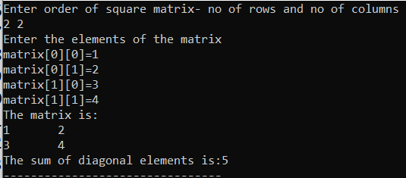
Prog. 8: WAP to read a square matrix and its elements and find the sum of diagonal elements (i.e. trace of matrix).

Slide 23
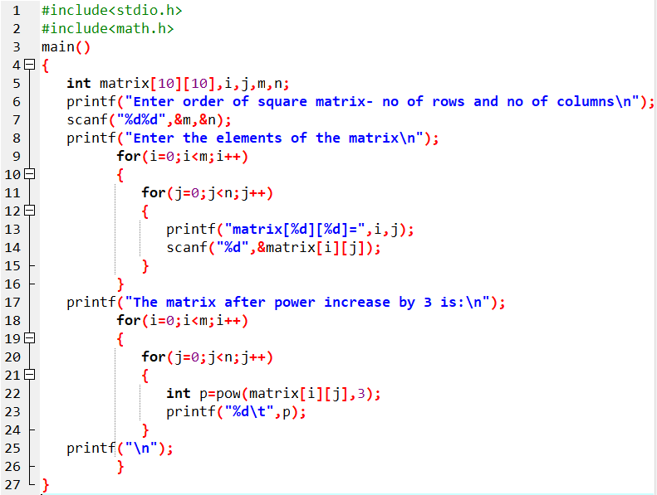
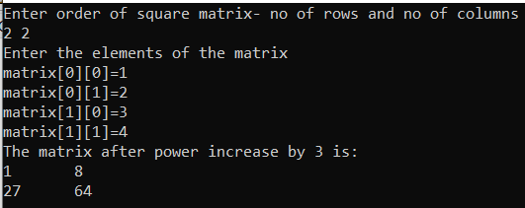
Prog. 9: WAP to enter a mxn matrix and display the matrix by increasing all the elements by power of 3.

Slide 24
Assignment 2:
WAP to read a square matrix and display the upper triangular matrix.
WAP to read a square matrix and display the lower triangular matrix.
WAP to read a matrix and display the individual sum of each row of the matrix.

Slide 25
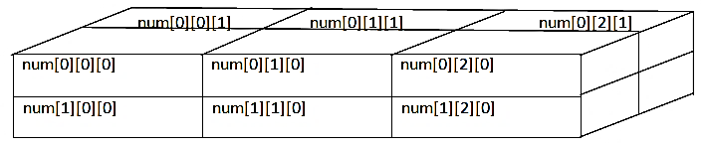
3-D Array
has three subscripts.
The general syntax :
Datatype ArrayName [sub1][sub2][sub3];
Eg:
int num[2][3][2];

Slide 26
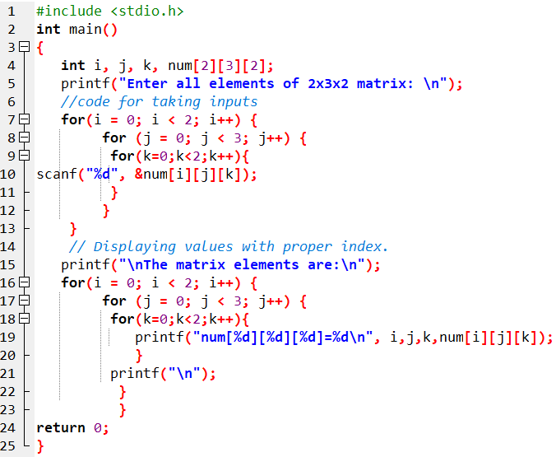
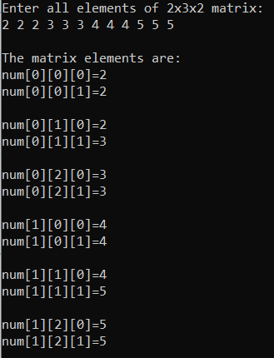
Prog. 10: WAP to create a 3-D array of size 2x3x2 to accept elements from user, and finally display them.

Slide 27
5.3 Character I/O statements
Character is any symbol that we give to the computer through the keyboard.
We use getchar() and putchar() for character input and output purpose.
Statement | Purpose | Syntax | Example
getchar() | used to enter character from keyboard. | Variable=getchar(); | lett=getchar(); where lett is a variable.
putchar() | used to display character on the screen. | putchar( variable or character); | putchar (lett); putchar(‘A’);

Slide 28
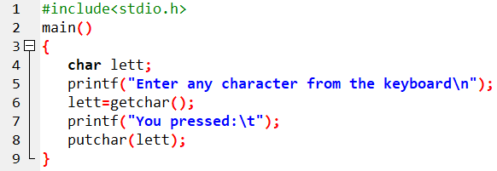
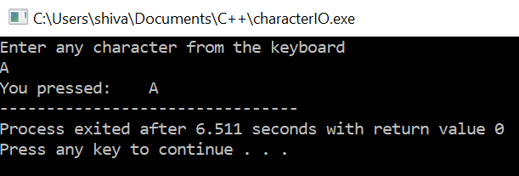
Prog. 11: WAP to enter a character and display it using character I/O statements.

Slide 29
5.4 Strings
array of characters (i.e. character array is known as string).
A string is a sequence of characters that is treated as a single data item.
A string is always terminated by a NULL character (i.e. \0).
Syntax for declaring strings:
char stringName [size];
Eg:
char name[20];

Slide 30
5.4 Strings (contd.)
Compile-time initialization of string:
Strings can be initialized as:
char name[]= [‘R’, ‘A’, ‘M’, ‘\0’];
or, we equivalently can write as:
char name[]= “RAM”;
Run-time initialization of string:
Strings can be initialized as:
char name[20];
gets(name);

Slide 31
5.5 String I/O statement
The gets() and puts() are used for input and output of strings.
Statements | Purpose | Syntax | Example
gets() | It reads a string from keyboard. | gets( variable name); | gets( name); where name is a variable.
puts() | It displays string on display. | puts( variable name or string data); | puts (name); puts(“RAM”);

Slide 32
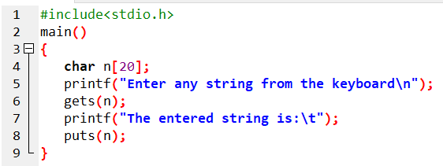
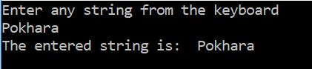
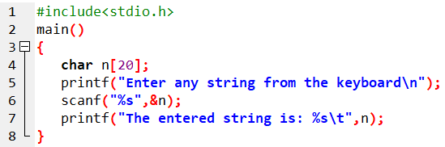
Prog. 12: WAP to enter any string from keyboard and display it using string I/O statements.
OR

Slide 33
5.6 String Handling Functions
Inbuilt functions defined in <string.h>
Used to manipulate string data.
strlen() | Returns the length of the string
2. strcpy() | Copies the content of one string into another string
3. strcat() | Joins two strings
4. strrev() | Returns the string in reverse order
5. strlwr() | Changes the characters of string in lower case
6. strupr() | Changes the characters of string in upper case
7. strcmp() | Compare two strings

Slide 34
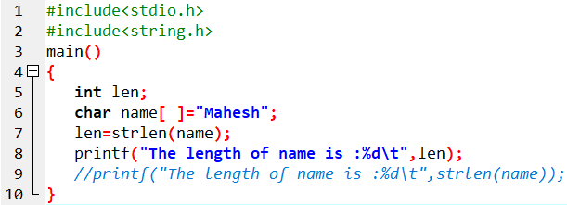
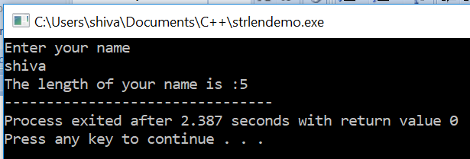
Prog. 13: WAP to initialize a string and display its length.

Slide 35
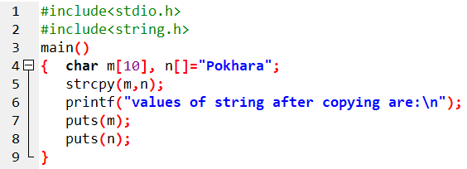
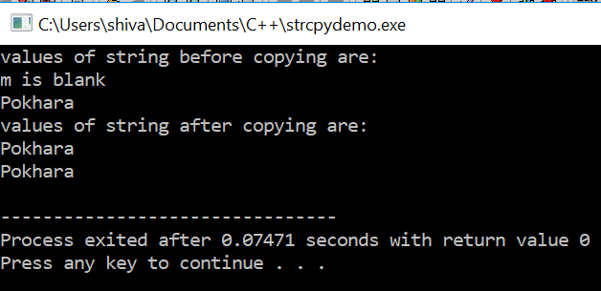
Prog. 14: WAP to demonstrate the use of strcpy().
Here, content
of n copied
to m

Slide 36
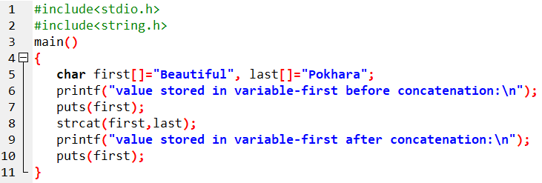
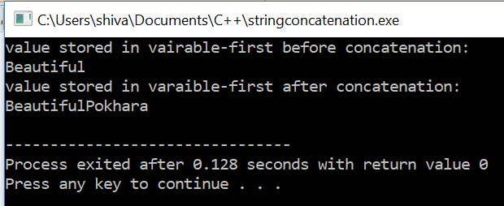
Prog. 15: WAP to concatenate a string to another string.
Here, content
of last is
concatenated
to first

Slide 37
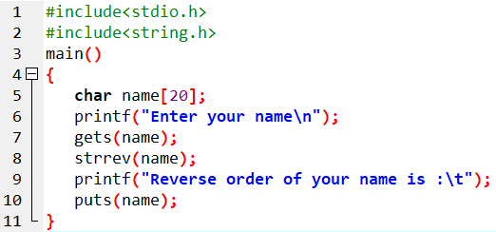
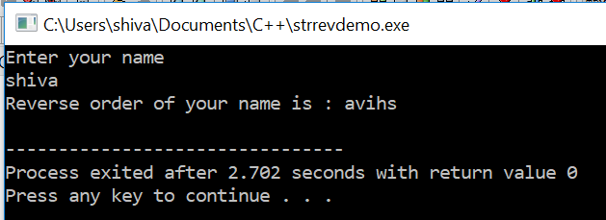
Prog. 16: WAP to reverse an input string using strrev()

Slide 38
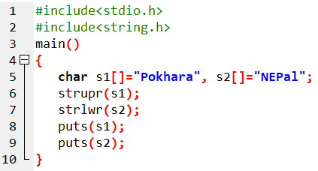
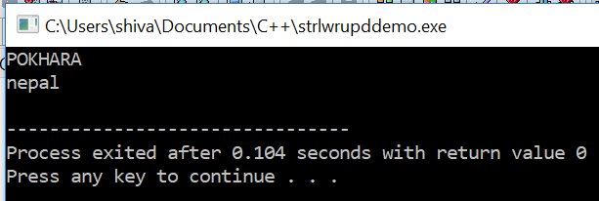
Prog. 17: WAP to change the case of strings.

Slide 39
String comparison
strcmp() is used for string comparison.
Compared as per dictionary case.
Actually, ASCII value of characters taken and then compared.
A-Z🡪 65-90
a-z 🡪 97-122
0-9 🡪48-57
If :
First string > Second string 🡪 1
First string < Second string 🡪 -1
First string = Second string 🡪 0

Slide 40
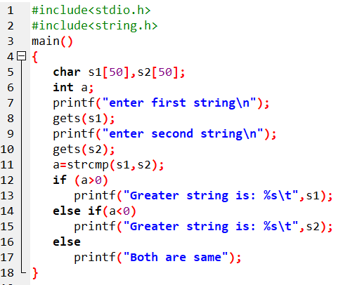
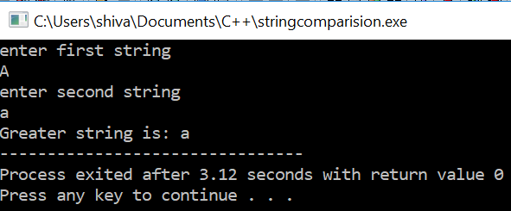
Prog. 18: WAP to compare two input strings.
If the inputs are Aa and aa : output is Greater is aa
If the inputs are ram and ramesh, output is Greater is ramesh.
If the inputs are ram and rajesh, output is Greater is ram.
If the inputs are apple and apple, output is Both are same

Slide 41
5.7 Array of String
An array of string is a 2-D array of character of character.
So, 2-D character array can be used to store list of name’s string.
Eg:
char name[5][30];
This may be used to store a list of 5 names each of maximum length of 30 characters.

Slide 42
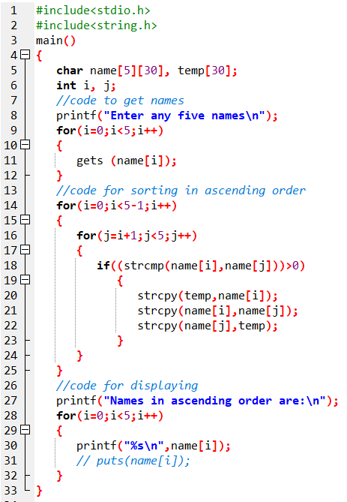
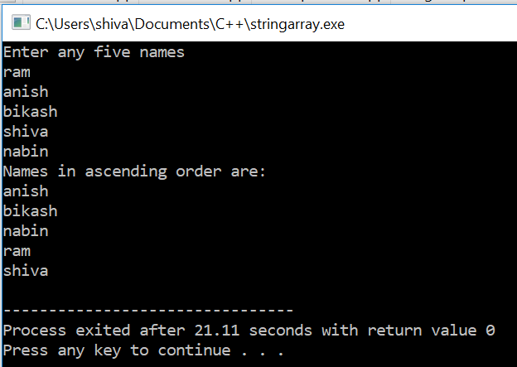
Prog. 19: WAP to read names of 5 persons and sort in ascending order, i.e. alphabetical order.

Slide 43
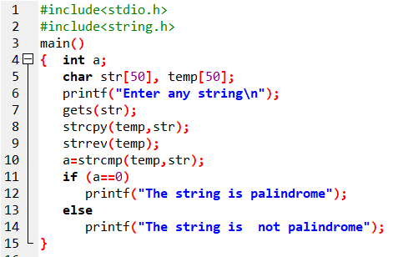
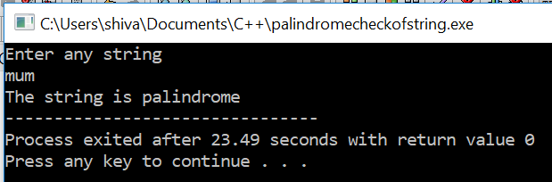
Prog. 20: WAP to input a string and check if it is palindrome.

Slide 44
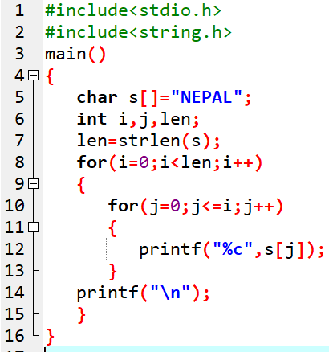

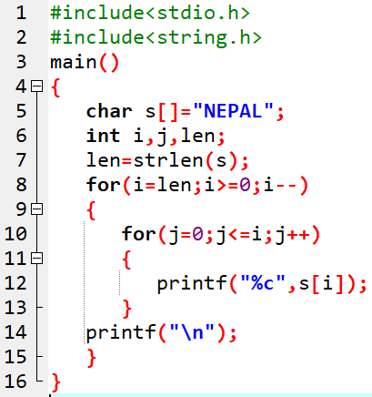

Prog. 21: WAP to display NEPAL as:

Slide 45
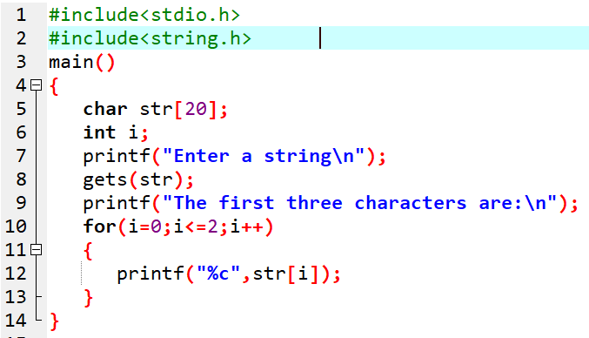
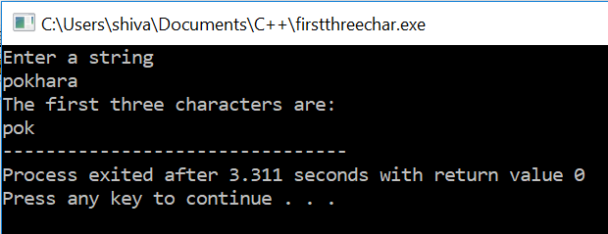
Prog. 22: WAP to take out only the first three characters from the entered string.

Slide 46


Prog. 23: WAP to enter a sentence (i.e. string) and count out the number of words in it.

Slide 47


Prog. 24: WAP to enter a string and count the number of vowels present in it.

Slide 48


Prog. 25: WAP to enter any five names and display only the names that begins from A.

Slide 49
Assignment 3:
WAP to input any five names and sort them in ascending order.
WAP to input any five names and sort them in descending order.
WAP, using array, to input any 10 numbers and display only the prime numbers from there.

Slide 50
End of Chapter

